Slide 1

09. Manage servers with Windows Admin Center
Megaseries

Slide 2
Introduction
WAC is a browser-based management tool for your Windows servers (and other devices or services)
It is meant to help you manage servers without opening a lot of tools like MMC consoles and the Server Manager
Management is done over WinRM with Powershell Remoting and WMI

Slide 3
Key points
It contains most of the tools you use to manage servers but recreated for this new, modern experience
It is extensible so if the included tools are not enough you can get more
Very easy to install and upgrades itself if an internect connection is available
Can manage hyper converged clusters, containers and virtual machines

Slide 4
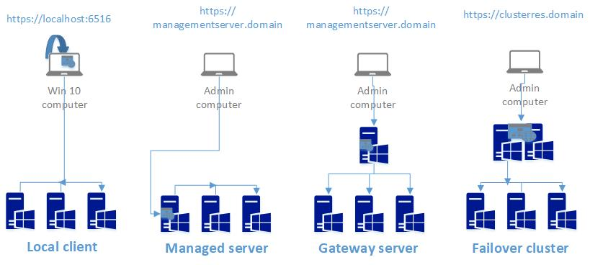
Install options
Notes:
Windows Admin Center has 2 modes of operation:
- Desktop mode: WAC is installed on a Windows 10 machine and it is accessed from that machine using localhost. Management commands are executed directly by the client machine
- Gateway mode: WAC is installed on a Windows Server and it is accessed from that server or other machines with a supported browser. Management commands are executed by the server
The possible installation options are:
- Local client: It is the only option that corresponds to the Desktop mode of operation
- Managed server: WAC is installed on a server that might have also other roles on it and that server then manages itself and others in the infrastructure
- Gateway server: WAC is installed on a server that has the dedicated role of a WAC gateway. Commands for managing other machines are executed by that server
- Failover cluster: WAC runs on a failover cluster. This scenario is used in case you need high availability for your Admin Center console

Slide 5
Installation
Get WAC from the link
The current GA version is 2103
Installation mode used in video: Gateway server

Slide 6
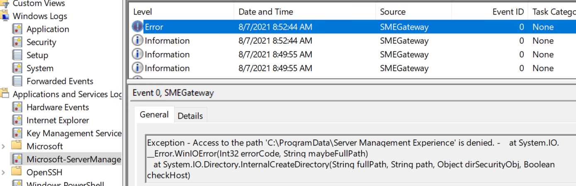
Fix page unreachable problem
After installing WAC wait 2-3 minutes and check the EventLog at Microsoft-ServerManagementExperience. If you get the following error apply the fix.

Slide 7
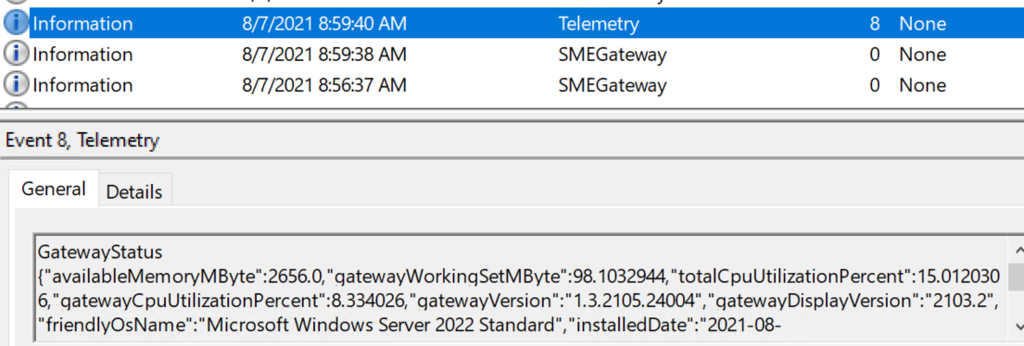
Fix page unreachable problem
Set the Network Service with Full Control on C:\ProgramData\Server Management Experience with This folder, subfolders and files
Restart service and wait about 2-3 minutes
If everything worked you should see the following log:

Slide 8

https://www.youtube.com/channel/UCcZ-jLbPwNr8E_v9-65n8Iw https://github.com/itknowledge4

